Slide 1
Basics of Maven
BUILD TooL
Presented By:
Devinder Singh Saggu

Slide 2
Maven Vs. Ant
 | Maven | Ant
1. | Maven is project management tool. Like black box where user don’t see the complexity behind build tool. | Mainly build tool works on build.xml which mentions what and how .
2. | Reusable plugins. | Scripts are not reusable.
3. | Convention Over Configuration. | Not formal conventional.
4. | Declarative means POM.xml. Dependency Management (including transitive) | Procedural. What to do and when to do. Like ordering of scripts.
5. | Project Lifecycle | Do not have project life cycle.
6. | It is framework. | It is tool box.

Slide 3
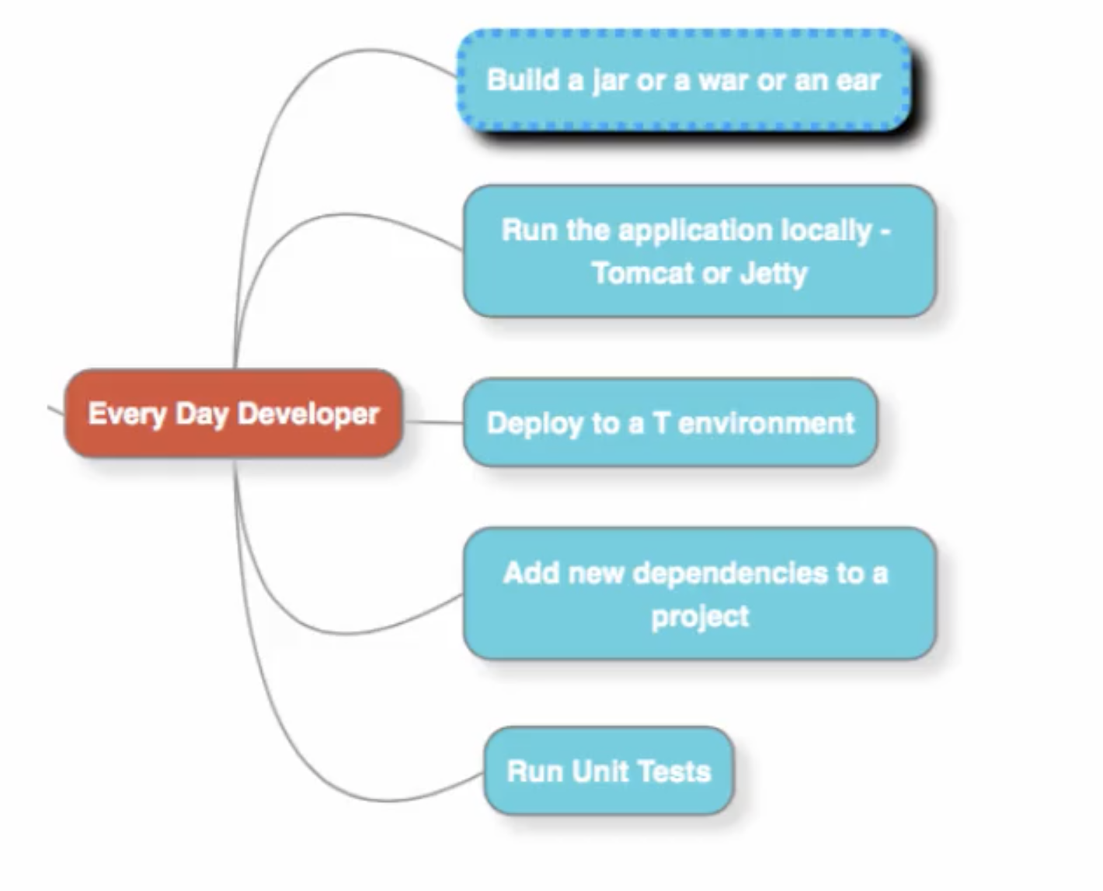
Developer Tasks

Slide 4
Configure Maven:
Configure on Windows:
https://mkyong.com/maven/how-to-install-maven-in-windows/
Configure on Mac:
https://mkyong.com/maven/install-maven-on-mac-osx/
Configure on Linux:
https://www.journaldev.com/33588/install-maven-linux-ubuntu

Slide 5
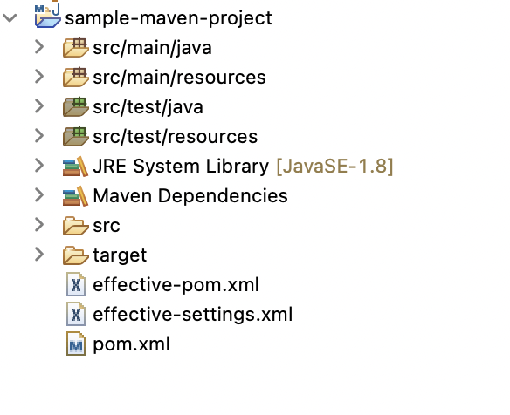
Basic Maven Project Structure:

Slide 6
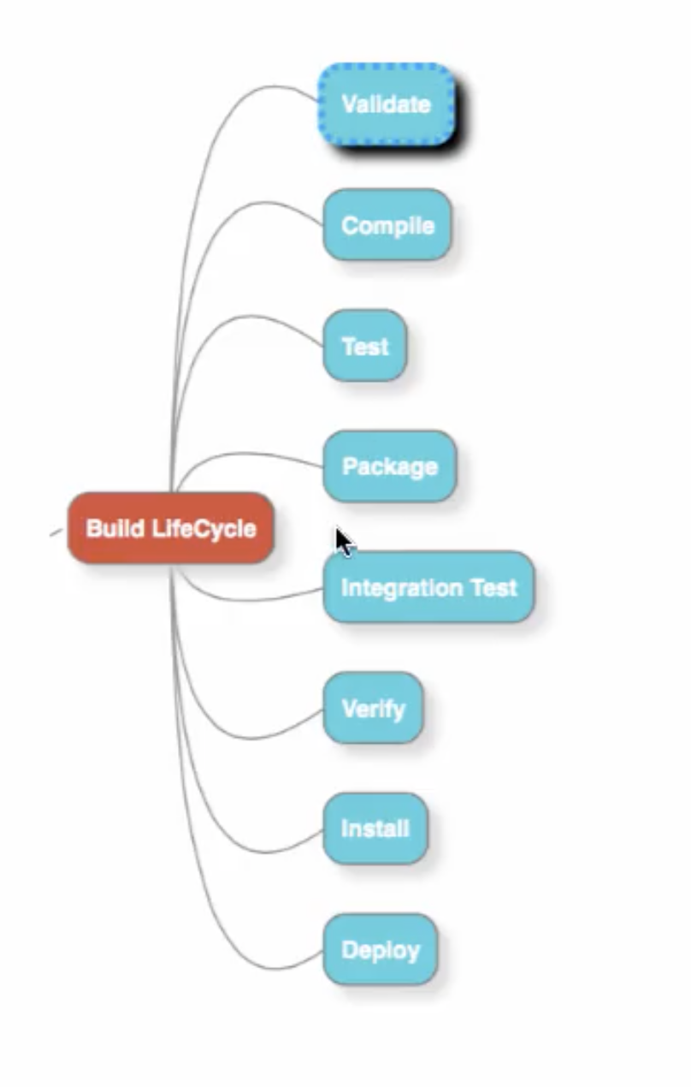
Maven Build LifeCycle:
It defines the steps maven follows when user execute command.
On running the specific maven command the earlier steps in build life-cycle executes automatically.
In Ant, we have to define these steps individually.

Slide 7
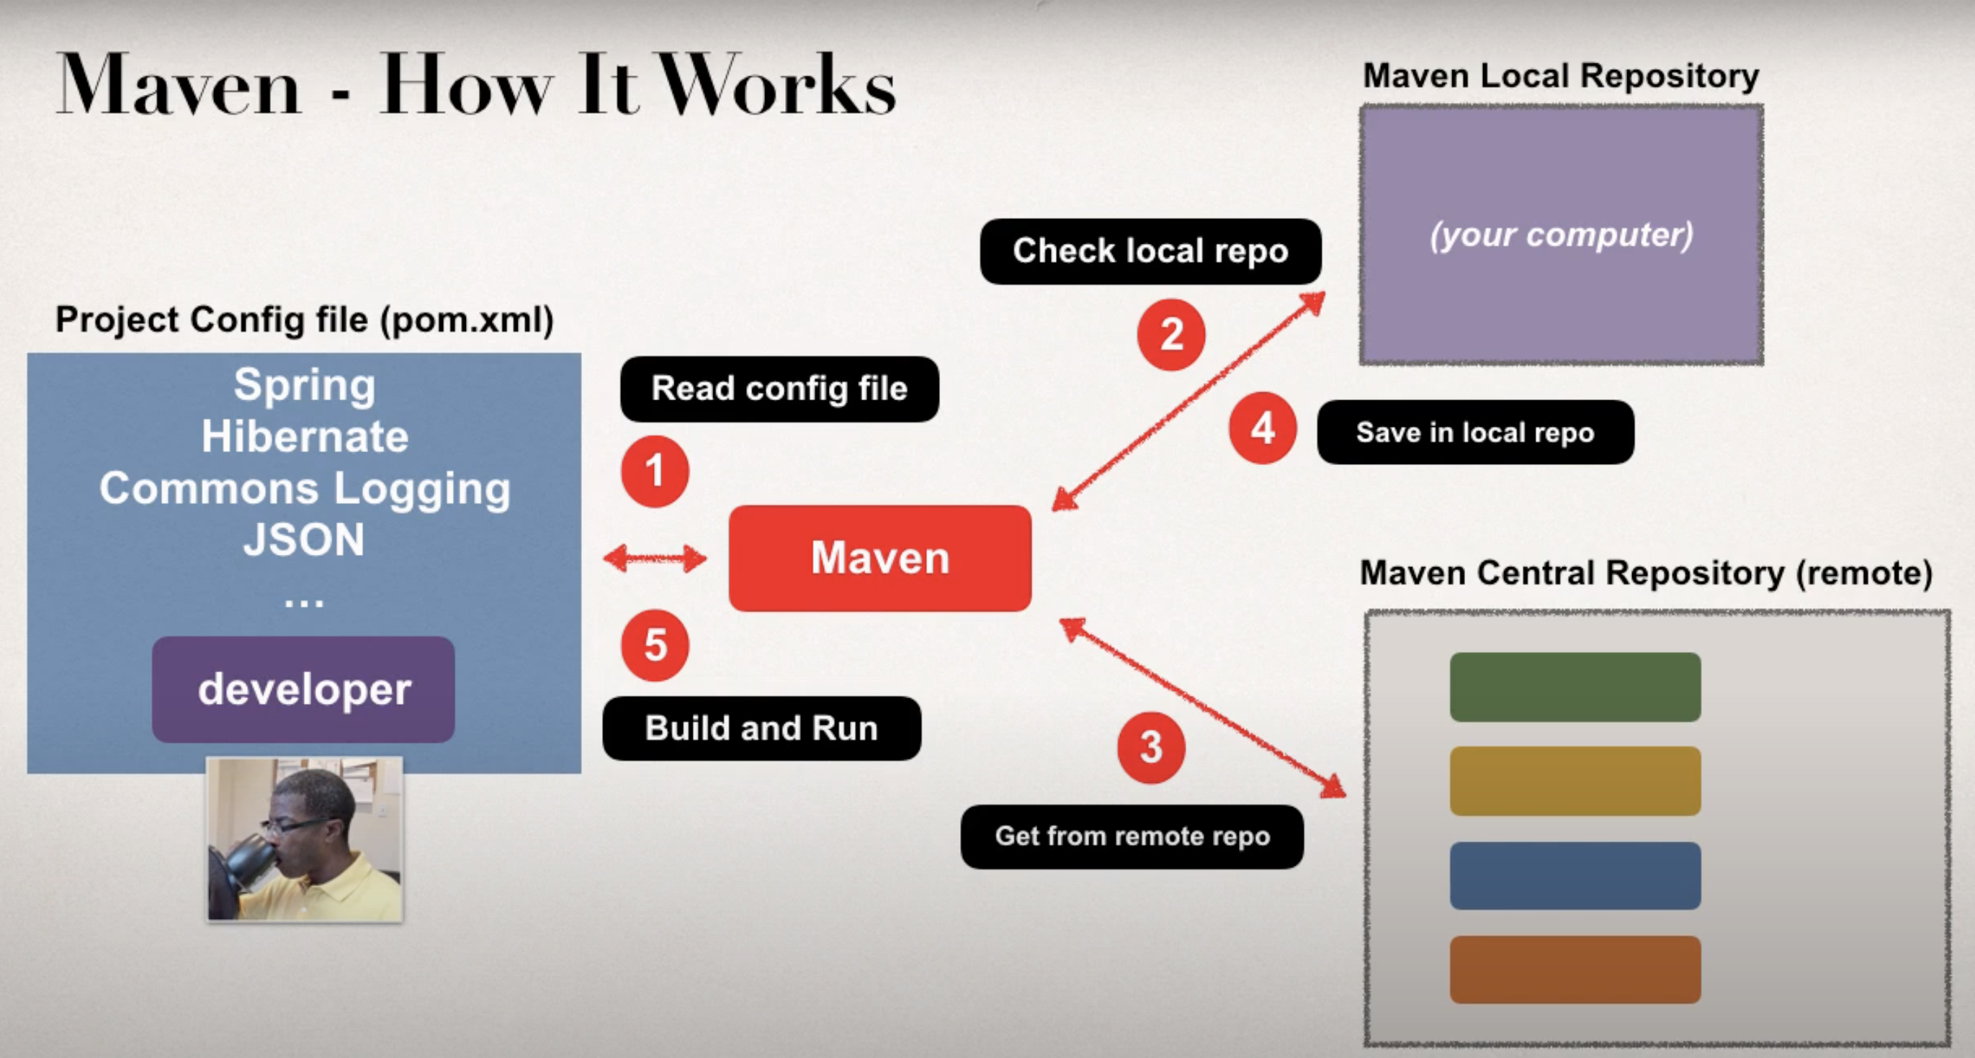
Background work by maven:

Slide 8
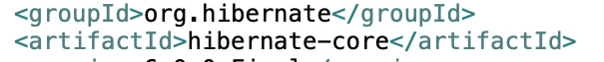

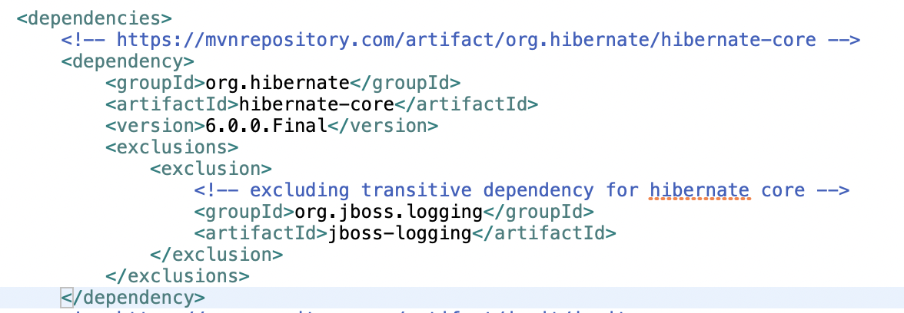
Understanding Maven POM
Uniquely identifies the project.
Snapshot means underdeveloped.
Resolves dependencies from maven repository.
Also downloads the transitive dependencies.
Exclude the unnecessary dependencies.

Slide 9
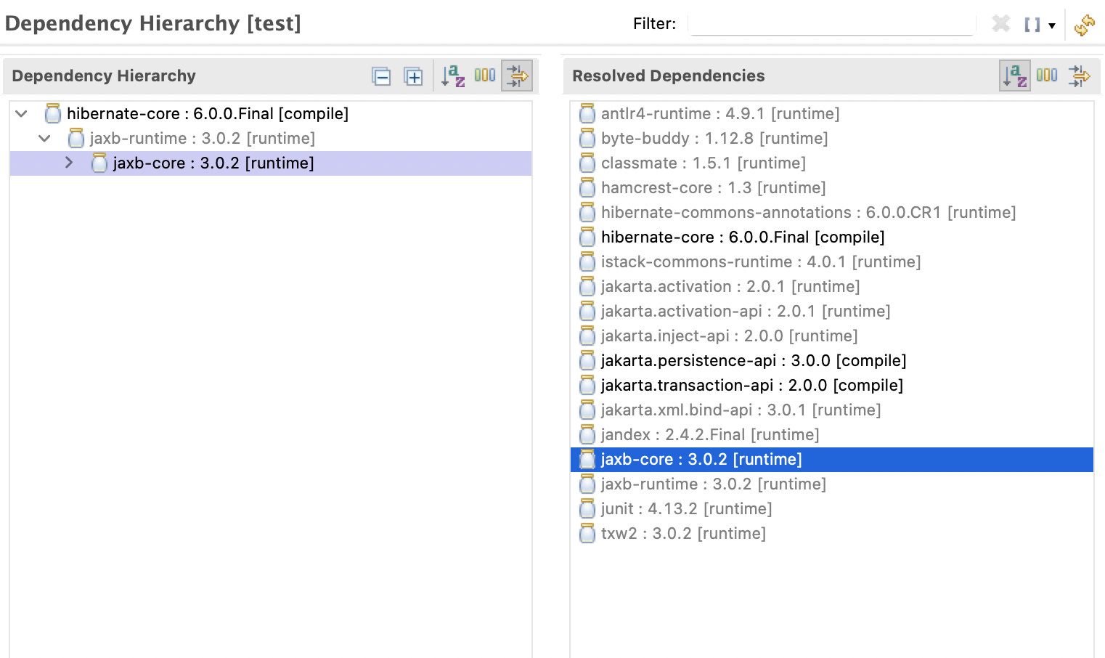
Transitive Dependencies:

Slide 10
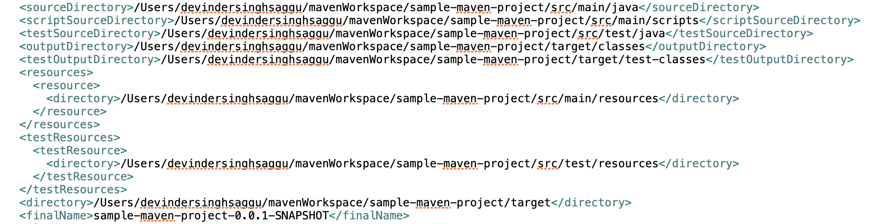
Effective POM:
Effective POM = POM + Super POM
Contains default conventional directories path.

Slide 11
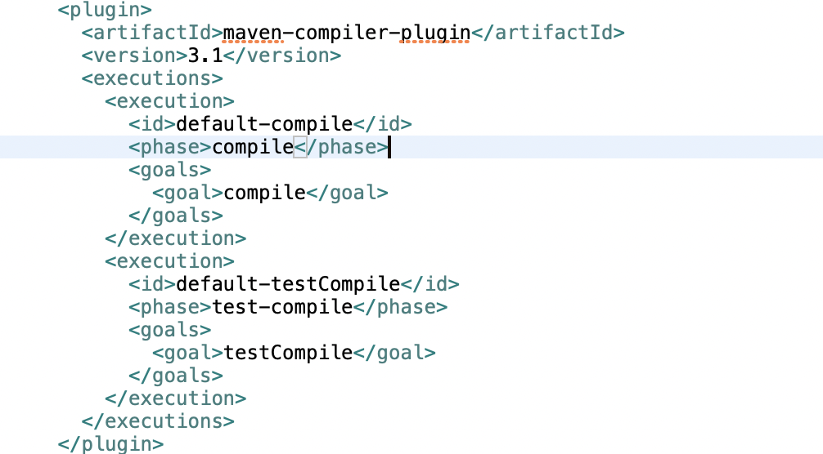
Cont…
Default plugins – Compiler, surefire (JUnit)

Slide 12
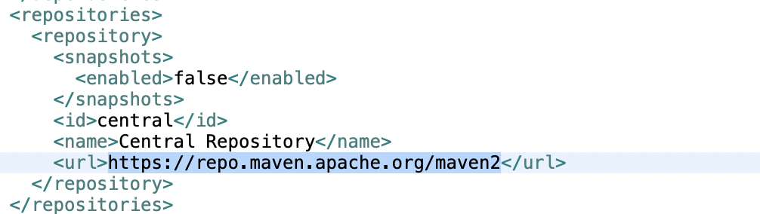
Cont…
Central Repository
Central Maven Repository

Slide 13
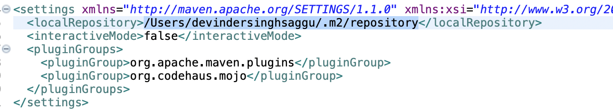
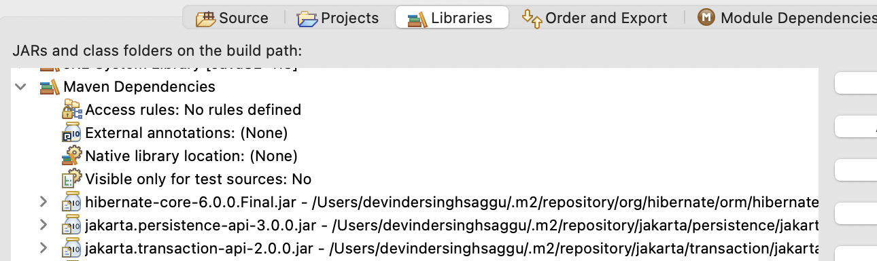
Local Repository:
Path for local repository can be found in effective-settings.xml which acts as cache.
Maven dependencies in build path.

Slide 14
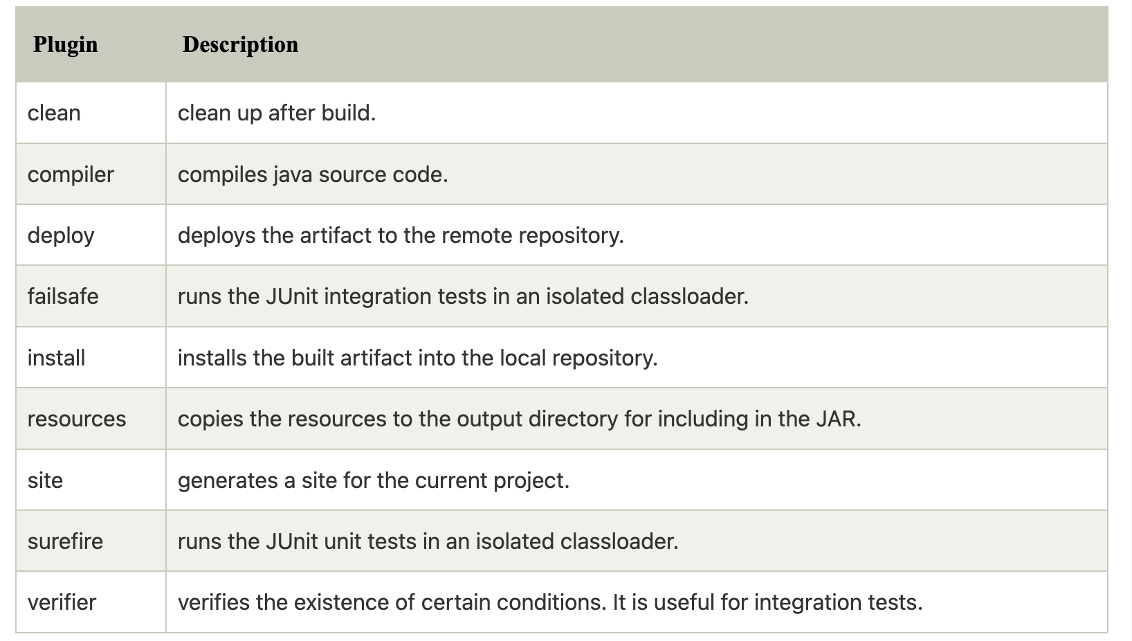
Maven plugins
The maven plugins are central part of maven framework, it is used to perform specific goal.
Build plugins – executed at the time of build. These plugins should be declared inside the <build> element.
Reporting plugins – executed at the time of site generation. Should be declared inside the <reporting> element.

Slide 15
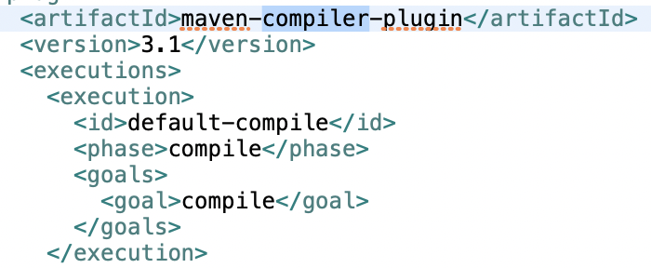
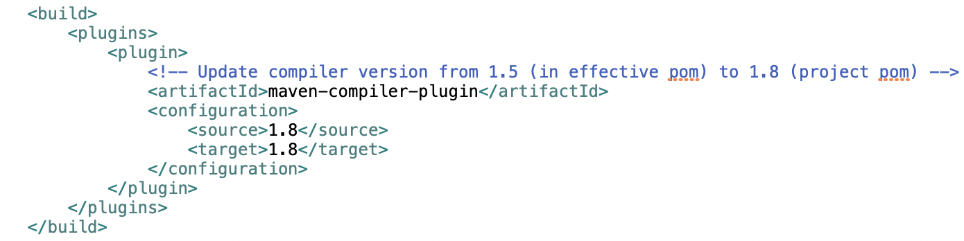



Compiler plugin:
Effective POM
Project POM

Slide 16
Dependency Scope:
compile – Default scope and are propagated to dependent projects.
runtime – required for execution only. Available in test and runtime classpath not in compile time classpath.
test – only available for test compilation and execution phases (JUnit or Mockito).
import - only supported on a dependency of type pom. It indicates the dependency is to be replaced with the effective list of dependencies. Since they are replaced, dependencies with a scope of import do not actually participate in limiting the transitivity of a dependency.
provided - JDK or a container to provide the dependency at runtime. For instance, dependency on the Servlet API and related Java EE APIs because web container provides those classes.

Slide 17
Multi module project:
Packaging should be POM. And packaging POM acts as parent POM for modules.
Here, business and data are modules with parent project multi-module-maven-project.
Data layer has dependencies for Spring and Hibernate.
Business layer has dependency for Spring framework.
Dependency management in parent POM mentions the versions of dependencies to be included in child POMs.
Include data. layer as dependency in business layer with built-in variable for version.
For version management of data module, mention it in parent POM.

Slide 18
Maven commands:
Version range for dependencies
help:effective-pom –Doutput=effective-pom.xml
mvn help:effective-settings –Doutput=effective-settings.xml
mvn clean install –DskipTests
mvn –X clean install >> sample.txt
mvn dependency:tree
mvn dependency:sources
mvn --help

Slide 19
References:
https://www.youtube.com/watch?v=I9MD-IGQDoo (ANT)
https://maven.apache.org/what-is-maven.html (Maven)
https://www.youtube.com/watch?v=m_eWc9pjyg4 (How it works)
https://stackoverflow.com/questions/33935281/command-not-found-oh-my-zsh
https://www.youtube.com/watch?v=oxToe-4c6OM
https://repo.maven.apache.org/maven2/org/apache/maven/plugins/ (Maven Plugins)

